Slide 1
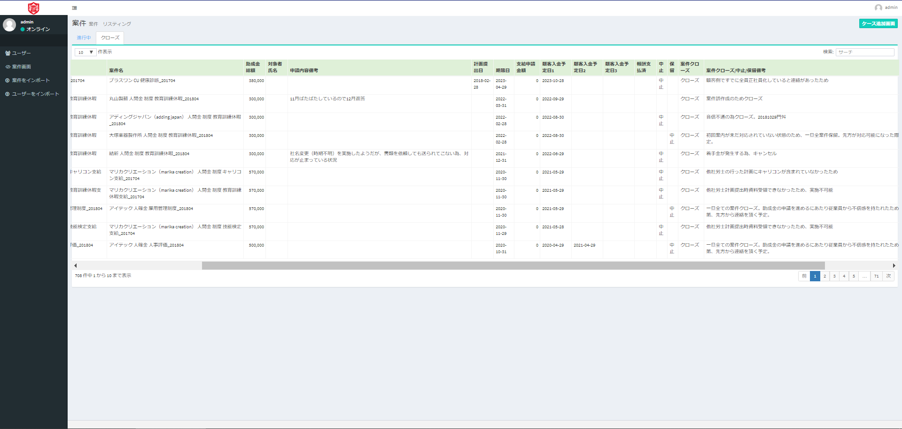
Admin > 案件画面
“クローズ”tab,
Headline should not return.
1 line, please.
“進行中”tab, it’s OK.
“中止””保留””クローズ” should not return.
1 line, please.
The sorting feature has disappeared. Please revive.
ユーザー screen can sort.

